Slide 1
The Positive Psychology of the Person-Centred Approach
Stephen Joseph
PCCS Anniversary Conference: Shared Practice in Non-Medicalised Mental Health Care, October 16th 2013

Slide 2
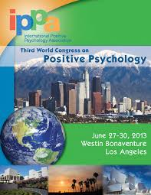
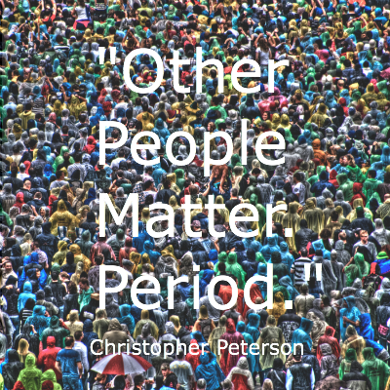
Positive Psychology
“The aim of positive psychology is to begin to catalyze a change in the focus of psychology from preoccupation only with repairing the worst things in life to also building positive qualities” (Seligman & Csikszentmihalyi, 2000, p. 5)

Slide 3
What do positive psychologists do?
Some topics of interest
Happiness
Meaning
Purpose
Gratitude
Curiosity
Empathy
Hope
Flow
Forgiveness
Some contexts of application
Education
Healthcare
Workplace
Clinical
Self-help
Lifespan
Policy

Slide 4
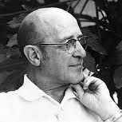
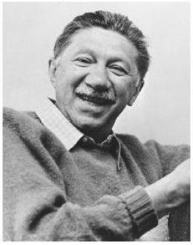
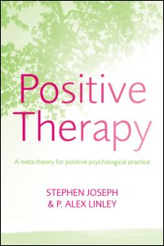
Person-Centred Approach is a Positive Psychology
“In the past, mental health has
been a ‘residual’ concept – the
absence of disease. We need to do
more than describe improvement in
terms of say ‘anxiety reduction’.
We need to say what the person
can do as health is achieved. As
the emphasis on pathology lessons,
there have been a few recent efforts
toward positive conceptualizations
of mental health. Notable among
these are Carl Rogers’ ‘fully
Functioning Person’, A. Maslow’s
‘Self-Realizing Persons” (Schlien,
2003/1956, p. 17)
(Joseph, S., & Linley, P. A. (2006). Positive
therapy: a meta-theoretical approach to positive
psychological practice. Routledge: London.)

Slide 5
Fully functioning
Open to experience
Exhibit no defensiveness
Interpret experience accurately
Flexible self-concept
Trust in own experiencing
Develop values in accordance with experience
Have no conditions of worth
Experience unconditional positive self-regard
Live in harmony with others
Positive psychology is not necessarily person-centred, but the person-centred approach is always a positive psychology

Slide 6
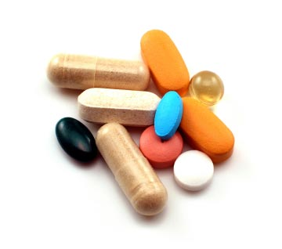
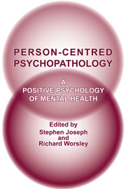
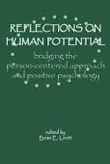
Person-Centred Positive Psychology
Challenges illness ideology
Understanding the full spectrum of functioning
Inform positive psychology practice
Joseph, S., & Worsley, R. (Eds.). (2005). Person-centred psychopathology: A positive psychology of mental health. Ross-on-Wye: PCCS books.
Worsley, R., & Joseph, S. (Eds.). (2007). Person centred practice: Case studies in positive psychology. Ross-on-Wye: PCCS books.
Levitt, B. E. (Ed.), Reflections on human potential: bridging the person-centred approach and positive psychology. PCCS Books.

Slide 7
Theory Consistent Measurement
Patterson, T., Joseph, S. (2007). Outcome measurement in person-centred practice. In: Worsley, R., Joseph, S., eds. Person-centred practice: Case studies in positive psychology. PCCS Books, pp. 200-215.

Slide 8
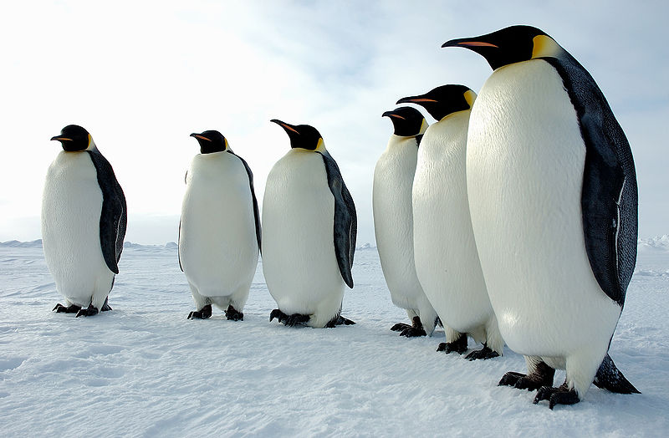
Authenticity Scale
Authenticity Scale
Please read of the following statements and rate
how well each describes you, where 1 = “Does not
Describe me at all” and 7 = “Describes me very well”.
1 I think it is better to be yourself, than to be popular
2 I don’t know how I really feel inside
3 I am strongly influenced by the opinions of others
4 I usually do what other people tell me to do
5 I always feel I need to do what others expect me to do
6 Other people influence me greatly
7 I feel as if I don’t know myself very well
8 I always stand by what I believe in
9 I am true to myself in most situations
10 I feel out of touch with the ‘real me’
11 I live according to my values and beliefs
12I feel alienated from myself
Scoring: total items 3, 4, 5, 6 for resistance to
external influences; 2, 7, 10 and 12 for self-alienation;
and items 1, 8, 9 and 11 for authentic behavior.
Wood, A. M., Linley, P. A., Maltby, J., Baliousis, M..,
& Joseph, S. (2008). The authentic personality: A
theoretical and empirical conceptualization and the
development of the authenticity scale. Journal of
Counselling Psychology, 55, 385-399.

Slide 9
Depression-Happiness Scale
A number of statements that people have made to describe how they feel are given below. Please read each one and tick the box which best describes how frequently you felt that way in the past seven days, including today. Some statements describe positive feelings and some describe negative feelings. You may have experienced both positive and negative feelings at different times during the past seven days.
Never Rarely Some- Often
times
I felt dissatisfied with my life.
I felt happy.
I felt cheerless.
I felt pleased with the way I am.
I felt that life was enjoyable.
I felt that life was meaningless.
Scoring
For items 2, 4, and 5: Never = 0, Rarely = 1, Sometimes = 2, Often = 3
For items 1, 3, and 6: Never = 3, Rarely = 2, Sometimes = 1, Often – 0
Add up all the scores. Lowest possible score is 0 and the highest is 18.
Rationale
Assesses well-being as a spectrum ranging from depressed state to a state of high functioning.
Reference
Joseph, S., Linley, P. A., Harwood, J., Lewis, C. A., & McCollam, P. (2004). Rapid assessment of
well-being: The short depression-happiness scale (SDHS). Psychology and Psychotherapy: Theory, Research and Practice, 77, 463-478.

Slide 10
Thank You for Listening
Email:
Stephen.Joseph@nottingham.ac.uk
Twitter:
ProfSJoseph
Blogs:
http://www.psychologytoday.com/blog/what-doesnt-kill-us
http://www.huffingtonpost.com/stephen-joseph/what-doesnt-kill-us-post_b_2862726.html

